Slide 1

Real-Time Object Detection for Autonomous Driving: An Empirical Study in a Small-Scale Urban Environment
Krittin Chaowakarn
Bachelor’s Thesis
Technical University of Munich
TUM School of Computation, Information, and Technology
Chair of Integrated Systems
Munich, September 10, 2025
Notes:
Hello and welcome to my presentation on “Real-Time Object Detection for Autonomous Driving: An Empirical Study in a Small-Scale Urban Environment”

Slide 2
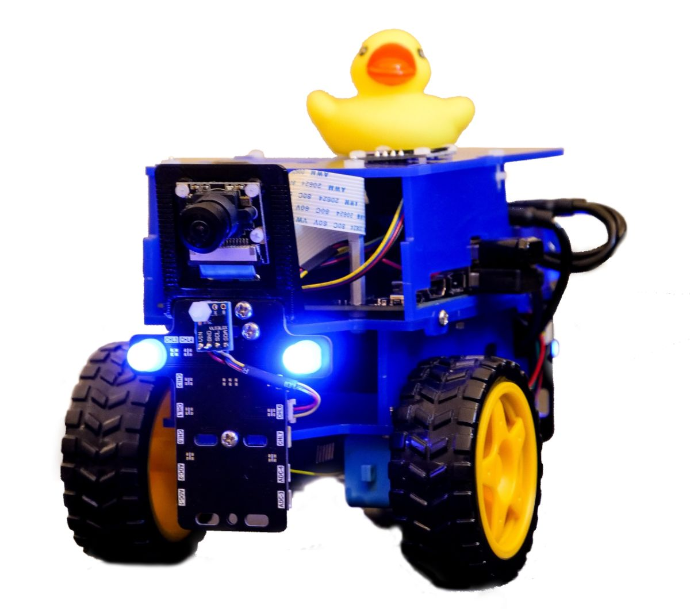
Introduction
(This thesis)
Time-of-Flight
Visual
CNN
Pros
Low CPU utilization
Precise localization
Cons
No object class
Sparse data point
Improvement
Able to locate Duckie
Detect only specific region
Pros
Low CPU utilization
Cons
Only 1 class
Improvement
Detect objects besides Duckies
Inference on GPU
Pros
Detect more classes
GPU utilization
Cons
Complexity
Picture from [1]
Notes:
Let’s start with an introduction.
Duckietown is a platform to study AI for autonomous driving using a small-scale urban environment. And this project focuses on a real-time object detection system for Duckietown.
The original work from Duckietown uses a Time-of-Flight or ToF sensor, which gives precise localization, but does not know what an obstacle is.
A work from our previous bachelor’s thesis student, Elena, implemented a visual-based algorithm by analyzing patterns on an input image. Still, it can detect only 1 class, that is Duckie.
I came up with an idea of using a convolutional neural network, or CNN, a special type of deep learning, to detect more classes besides Duckie, and using a GPU for its inference.

Slide 3
Presentation Outline
Background Knowledge
Dataset, Data Collection, and Fine-Tuning YOLO Models
Fundamental Decision Making
Results
Case Study
Conclusion and Outlook
Notes:
Here is today's presentation outline.
We start with basic knowledge and then go to more detail on the dataset, data collection, and fine-tuning of YOLO models, fundamental decision-making, some case studies and results, and the conclusion and outlook.

Slide 4
Background Knowledge

Slide 5
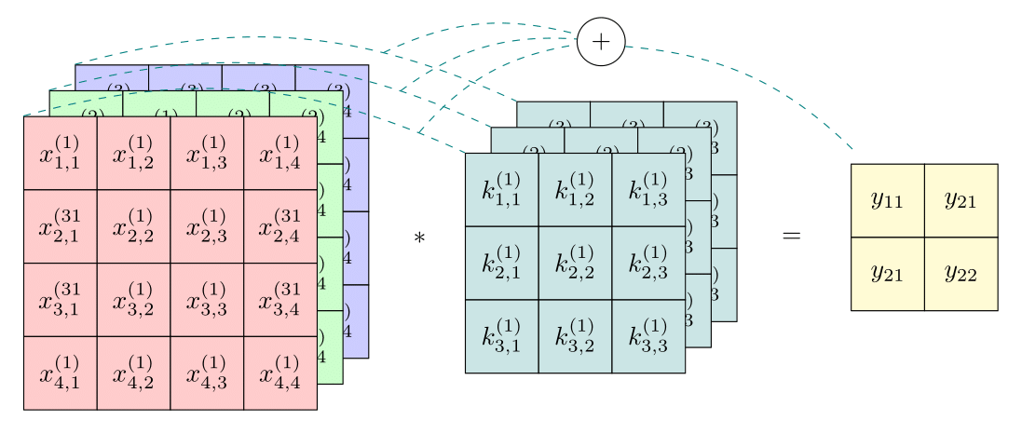
Convolutional Neural Network (CNN) and Key Advantages
Key Advantages
Gathering local features
Strong generalization
Fewer parameters
Hierarchical Features
Parallelization on GPU
Notes:
This is a picture of a part of a CNN. And here are some key advantages I would like everyone to know before we go deeper into my thesis.
First, it can gather local features because it considers small image regions instead of processing pixel-by-pixel.
Next, it has strong generalization and uses fewer parameters than a general neural network.
The last two essential concepts for this thesis are hierarchical features, meaning that each stage of a model represents a different feature level, and last but not least, it can be parallelized on a GPU.
This is very important for our lab because we have always put a workload on the CPU. Therefore, CPU utilization is almost 100 percent, and we need to switch to a GPU.

Slide 6
Basic CNN-based Models for Object Detection
One-Stage Model
Two-Stage Model
One-stage model
Faster
Less precise
Two-stage model
Slower
More precise
Input Image
Input Image
Model
Model
RPN
Feature Map
Proposals
Predictions
Det Head
Predictions
RPN: Region Proposal Network
Det Head: final conv block for refinement
Notes:
There are two basic CNN-based models: one-stage and two-stage models.
A One-stage model accepts an input image and returns an output prediction.
On the other hand, a two-stage model requires an RPN, or region proposal network, or we can see it as a tiny object detection model inside a larger one. An RPN is used to select a highly-featured region inside a feature map before getting the final prediction.
As you can see, a one-stage model is likely faster but less precise, opposite to a two-stage model, but since we focus on a real-time application, we choose a one-stage model for our thesis.

Slide 7
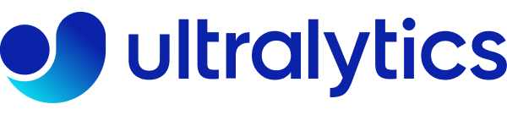
You Only Look Once (YOLO) Models
YOLO is a series of real-time object detection systems, maintained by Ultralytics [2].
YOLO has 12 different versions:
YOLOv1-v7 (2015-2022)
Old
Only object detection
YOLOv8-v12 (2023-2025)
Modern
a full range of vision AI tasks
We use only smallest model from each version to ensure a lightweight option.
Notes:
This is YOLO, You Only Look Once models. It is a framework maintained by a company called Ultralytics. It has 12 different versions with different sizes, from the smallest, called nano, to the largest, called “extra large”. Versions 1 to 7 are old. Versions 8 to 12 are more modern and sophisticated in solving computer vision problems.
So, we select only nano version 8 to 12 for our thesis, which ensures the smallest size possible and maintains a high-performance model.

Slide 8
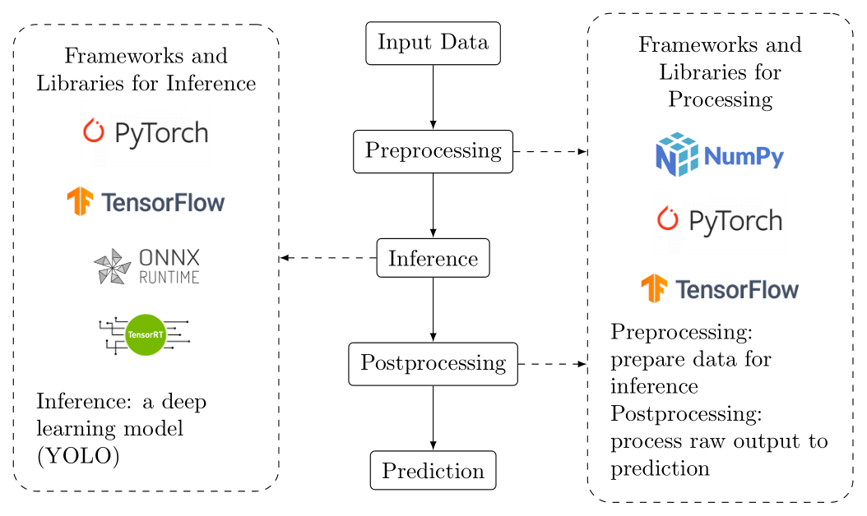
Pipeline and Frameworks
Notes:
Let’s see our pipeline and frameworks.
There are 3 stages before getting an output: preprocessing, inference, and postprocessing.
Preprocessing prepares data for the inference, while postprocessing converts a raw output into a prediction. Conversely, inference is a deep learning model. In our case, it is a YOLO model.
There are also some frameworks that I want to mention here.
Both pre- and postprocessing can rely on NumPy, which runs only on a CPU, and PyTorch and TensorFlow, which can run on CPU and GPU. In theory, any of them can be used for the inference, but more optimized options are ONNX Runtime and TensorRT.
In our case, we prioritize inference time, so we aim to use only an optimized framework.
We attempted to use TensorRT because it is a hardware-specific and optimized framework. Still, it gives poor results, even though mathematically it should be the same. So, this thesis uses ONNX Runtime for inference.
For both processing stages, TensorFlow conflicts with Duckietown software, and PyTorch on GPU also conflicts with ONNX Runtime.
This thesis can use NumPy and PyTorch on CPU for processing and only ONNX Runtime for inference. I also conducted experiments by changing the processing framework and hardware where inference runs on to ensure a real-time application.
To sum up, this thesis can use NumPy and PyTorch on CPU for processing and only ONNX Runtime for an inference. I also conducted some experiments by changing processing framework and harvard where inference run on to ensure real-time application.

Slide 9
Dataset, Data Collection, and Fine-Tuning YOLOs

Slide 10
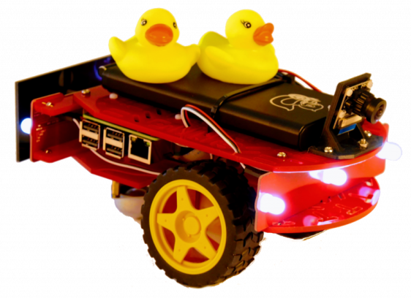

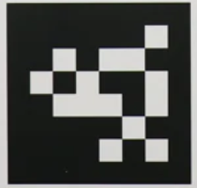
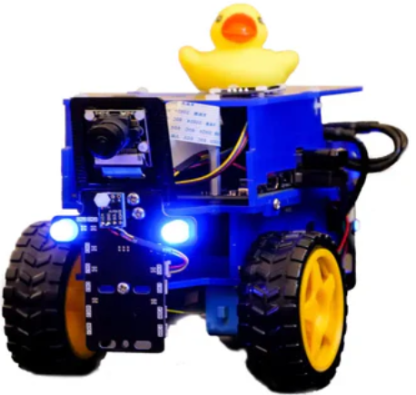

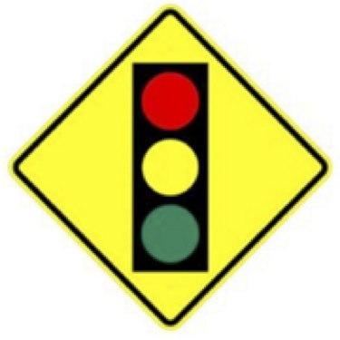
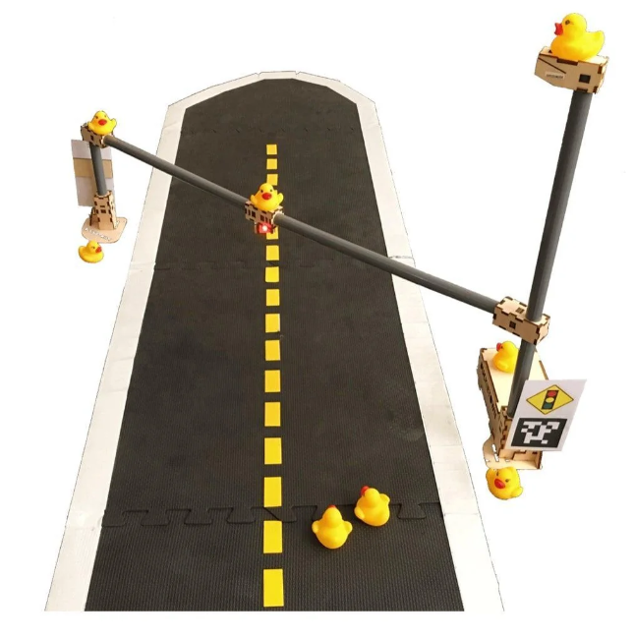
Datasets
Open-Source Dataset from Duckietown [3]
7 Classes:
Key difference from our lab:
New Duckiebot design
Just three classes
Lighting conditions
All images in this slide can be found on [4]
Notes:
We have an open-source dataset from Duckietown containing 7 classes: …….
And here are some differences between the open-source dataset and our lab environment.
We have a new Duckiebot design. As you can see, the previous version is red, while ours are blue. We only focus on 3 classes. And lastly, we have different lighting conditions.

Slide 11
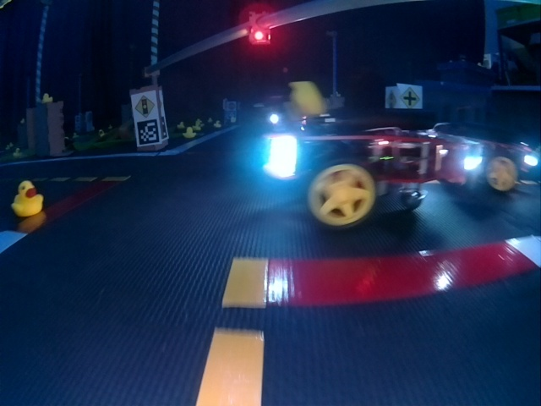
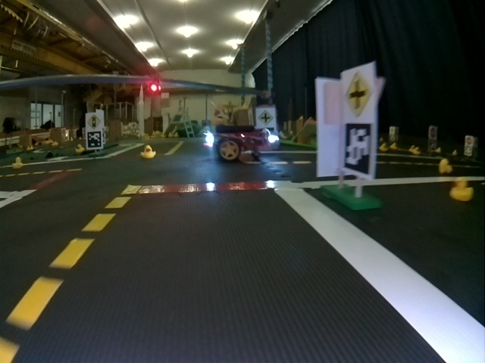
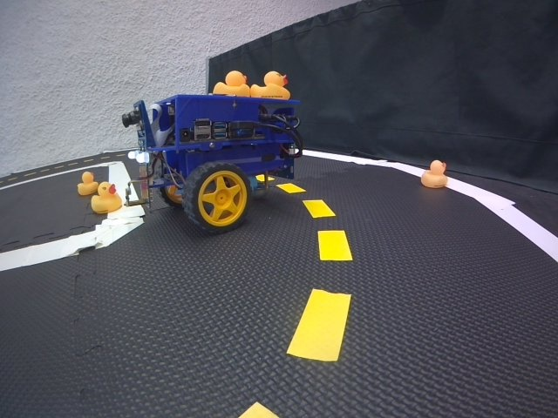
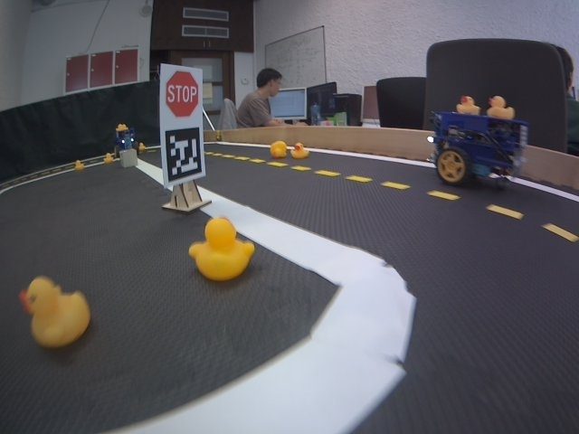
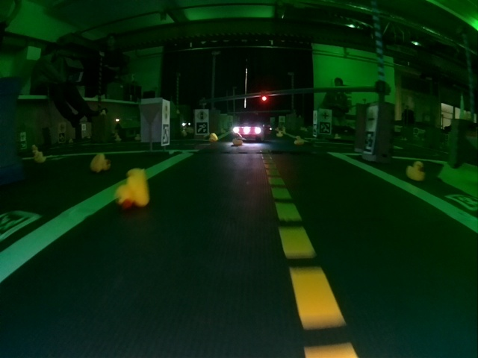
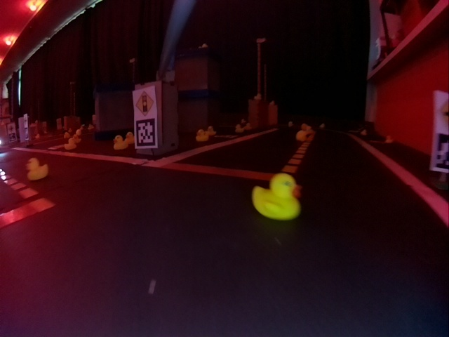
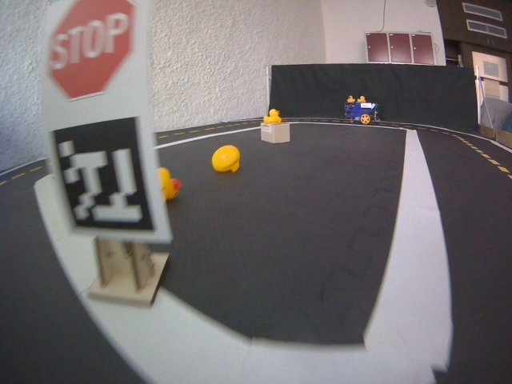
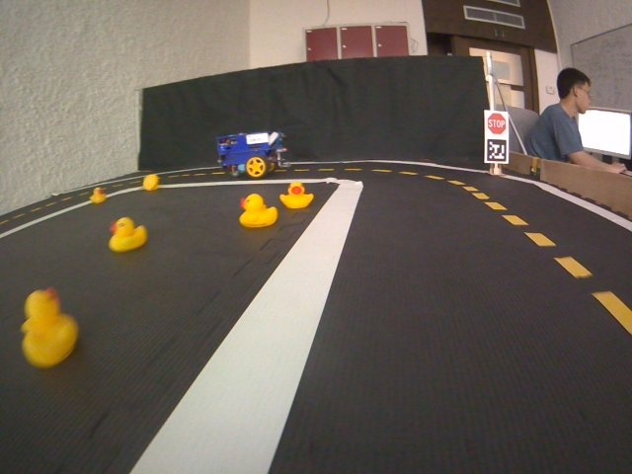
Datasets
The Open-Source Dataset
Our Environment
Possible Solutions
Collect a new dataset (too much effort)
For training
For fine-tuning
Collect a little data for evaluating
Notes:
Here are some examples of the open-source dataset images and our environment. With such different lighting conditions, I came up with 2 possible solutions.
One is to collect a new dataset, but it requires too much manual work.
And two is to collect a little data for an evaluation. So, we can select YOLO models directly based on our environment.

Slide 12
The Open-Source Dataset Distribution
Notes:
This is the open-source dataset distribution. From over 1800 images, only 45 percent quite align with our environment, while the rest contain color light.

Slide 13
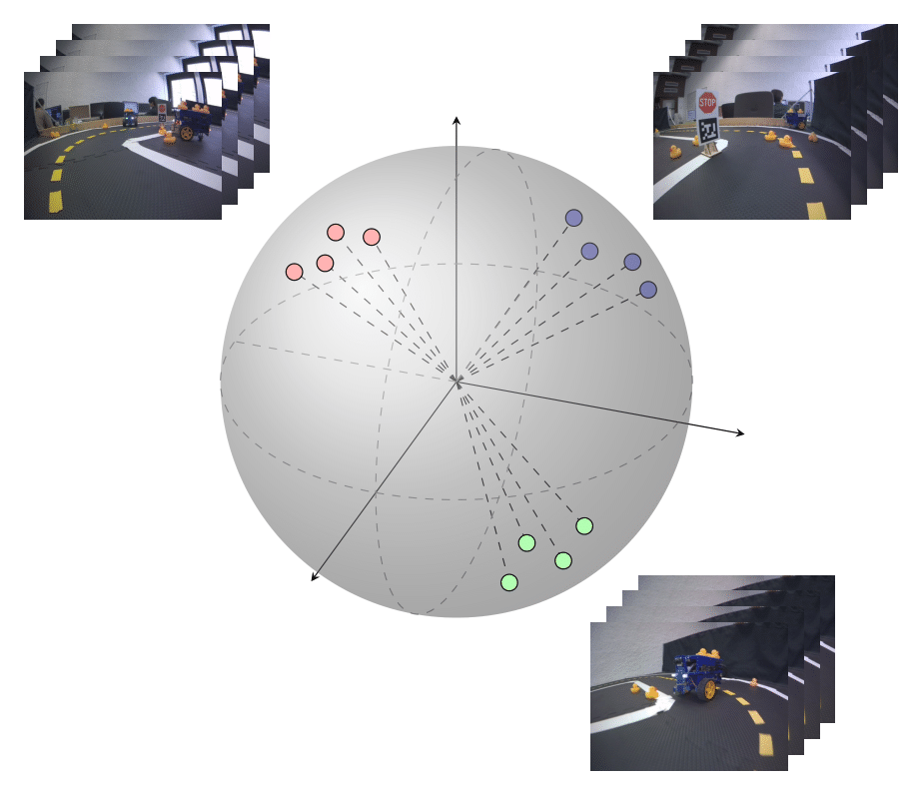
Data Collection and Selection Process
Data Collection
Automatically collect every 1 seconds
Selection Process
Use a model fine-tuned with the open-source dataset to extract feature
L2-norm
Collected Images
Backbone
Det Head
Prediction Results
Feature Vectors
K-means clustering (K=100)
Notes:
This is a data collection and selection process. Actually, by this stage, we should have a fine-tuned model to support the data selection process.
We simply collect an image every 1 second. After data collection, as visualized here, with the hierarchical feature property of a CNN, we can use a fine-tuned model to extract features and apply normalization and K-clustering to obtain distinct images.

Slide 14
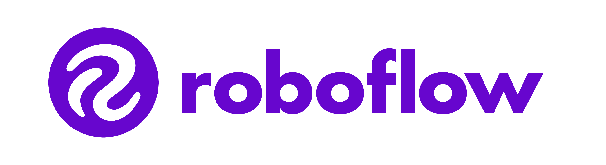
Processing All Datasets into YOLO Format
Open-Source Dataset (in XML)
Open-Source Dataset
(in YOLO format)
Selected Images
Model
Initial Custom Dataset
(in YOLO format)
[5]
Final Custom Dataset (in YOLO format)
Manually fix wrong
labeling and remove redundant images
Predictions
(pseudo labeling)
Notes:
This is how I prepared dataset.
We first convert the open-source dataset from XML into YOLO Format through RoboFlow, an online annotation tool. Then we use the formatted open-source dataset to fine-tune our model, and use it here to extract first prediction, called pseudo labelling. combine together to get initial custom dataset. We feed this custom dataset into roboflow and manually fix wrong labelling to get the final and clean custom dataset.

Slide 15
Fine-Tuning YOLO Models
Fixed (common practice):
Learning rate = 1e-4
Epochs = 100
Batchsize = 16
Varied:
Input size = 640, 480, 320, 160 (width/height of a square image)
Versions of YOLO nano
Note: COCO is a large-scale object detection, segmentation, and captioning dataset (330K images).
Pre-Trained YOLO Models (COCO [4] Dataset)
Fine-Tuning
Fine-Tuned YOLO Models (Open-Source Dataset)
Notes:
This is how we fine-tuned YOLO models by using pre-trained YOLO models and the open-source dataset. Here we varied input sizes and YOLO versions. Fundamentally, we have 16 different options in this thesis.

Slide 16
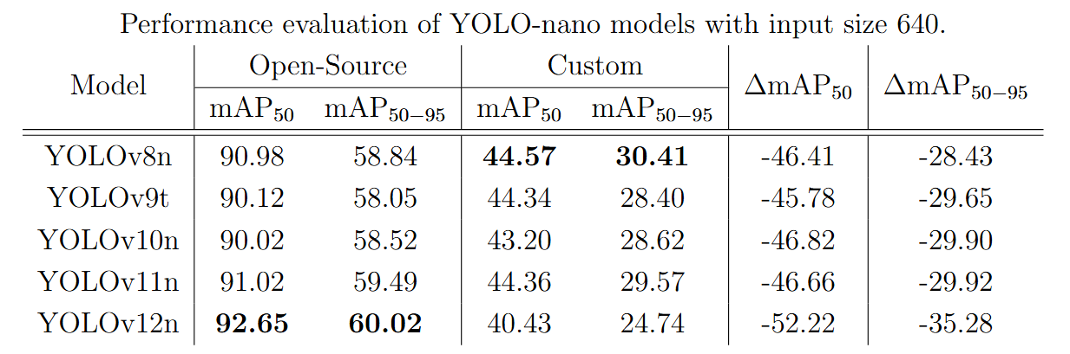
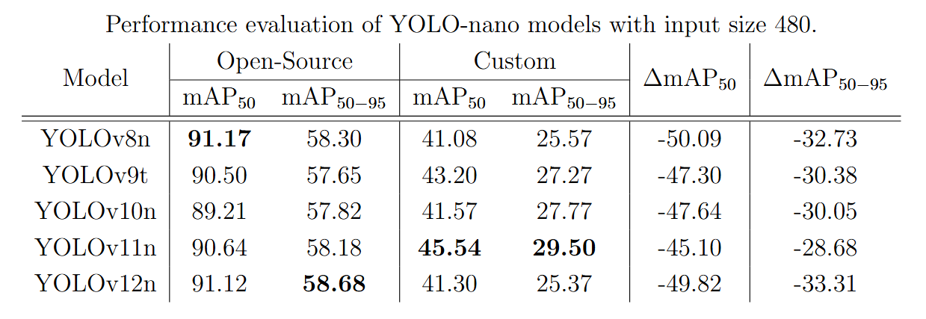
Fine-Tuning Results
640x640px Input Resolution
480x480px Input Resolution
From previous stage, we selected only YOLOv11n with input size of 640 and 480 based on their performance on our custom dataset.
Notes:
Here are some results.
With a 480x480 input resolution, YOLOv11n performs best on our custom dataset.
For larger resolution, all models perform almost at the same level, so we select YOLO version 11 nano for both 640 and 480 input sizes.

Slide 17
Fundamental Decision Making

Slide 18
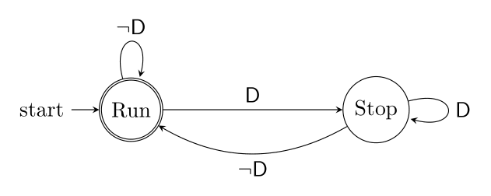
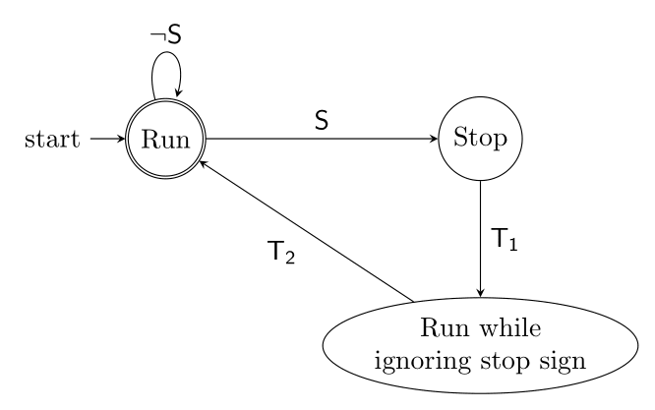
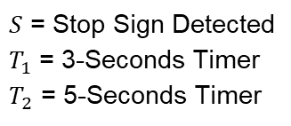
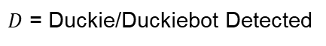
Stop-and-Wait System
Duckie/Duckiebot Detection
Stop Signs Detection
$S$ = Stop Sign Detected
$T_{1}$= 3-Seconds Timer
$T_{2}$ = 5-Seconds Timer
$D$ = Duckie/Duckiebot Detected
Notes:
For the fundamental decision-making system, we simply create two systems.
One for Duckie and Duckie. If the Duckiebot sees a Duckie or another Duckiebot, it will stop.
Another system is for a stop sign. If the Duckiebot sees a stop sign, it will stop for 3 seconds. After that, it will run while ignoring any stop signs for 5 seconds.
But both systems are a bit too naive, so we have some detection policies for them.

Slide 19
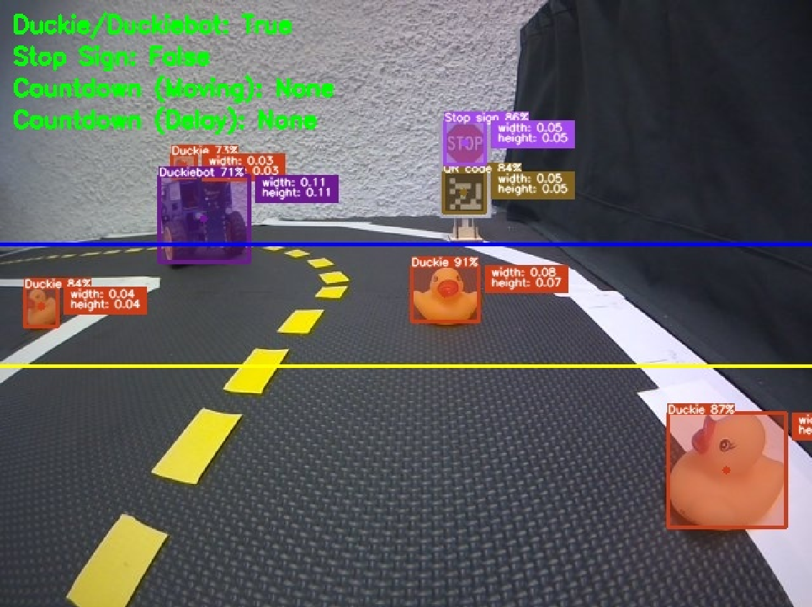
Simple Rule-Based Decision Making
Region-Based Method
Below blue line: Duckiebot
Below yellow line: Duckie
Normalized Object Dimension-Based Method
Duckie: Threshold = 0.08
Stop sign: Threshold = 0.1
Notes:
Region-based method and normalized object dimension-based method.
The first method is simple: if the center of a Duckiebot or a Duckie is below its line threshold, our Duckiebot will stop. The blue line is for Duckiebots, and the yellow line is for Duckies.
The second method aims to use the normalized width and height of Duckies and stop signs to decide whether or not to stop.
For example, this Dukie is very near and below the yellow line, so the caption here says True. On the other hand, a stop sign is really far away based on its dimensions, so our Duckiebot does not consider that.

Slide 20
Results

Slide 21
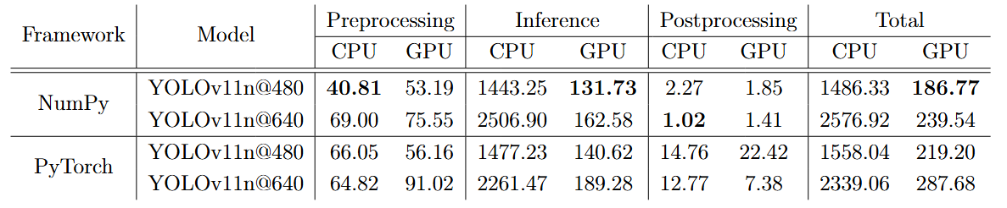
Processing and Inference Times During Deployment
Times in milliseconds, results averaged over 30-step moving average.
Pre- and postprocessing always on CPU
Runtime on GPU is always faster than runtime on CPU
Notes:
Here are results during model deployment.
Before starting, I want to mention that CPU and GPU labeled indicates hardware that a model runs on, while pre and post processing will always run on CPU.
Because all results are not always stable, I would like to point out some important keys.
First, for processing, NumPy is often faster than PyTorch, as can be seen in both columns.
Second, GPU inference, always faster than CPU inference.
Lastly, YOLOv11n with numpy on GPU gives the best runtime performance since it can run less than 200 ms.

Slide 22
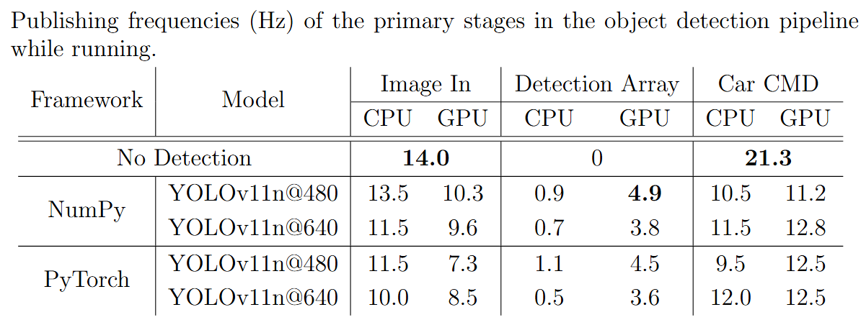
ROS Publishing Frequencies During Deployment
Frequencies of important topics in Hz
Publishing Rate of Detection Array on GPU is always faster than on CPU
Notes:
This is the ROS publishing rate.
Image In, Detection Array, and Car CMDrefer to how often we get an image, a detection result, and car command. Car command is basically velocity and direction for a Duckiebot.
We can clearly see that without a detection model, both image in and car CMD perform at best.
However, we focus on the detection array because it shows how frequently a Duckiebot can make a decision. We obtain 4.9 Hz here on YOLOv11n with numpy on GPU which outperform other setups. One thing that’s worth mentioning is car command of all setups. Even though all results here are around 10 Hz, they are fast enough for real-time application.

Slide 23
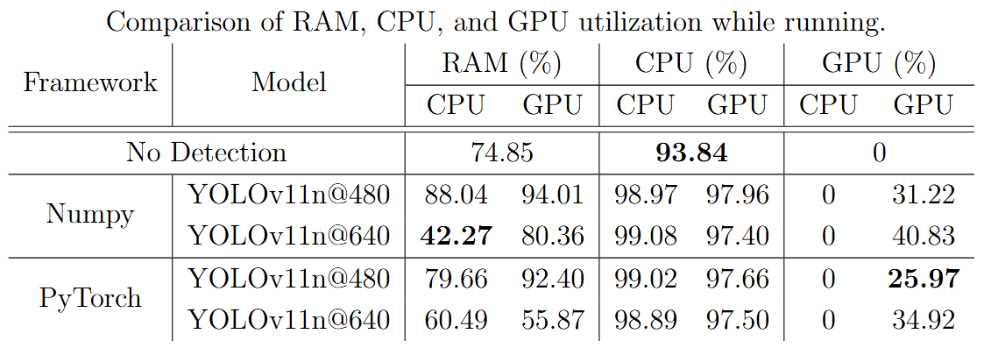
Hardware Utilization During Deployment
RAM, CPU, and GPU Utilization when Inference is on CPU and GPU
GPU utilization remains below approximately 40%
Notes:
Next is the hardware utilization result.
we can see the trend on the RAM utilization that it is greater when a model runs on GPU. This is because our hardware is the NVIDIA Jetson Nano and it does not have dedicated RAM, so it uses a shared system RAM. For CPU utilization, we can reduce around 1-2 percent when a model runs on GPU compared to CPU.
Lastly, for GPU utilization, it remains below approximately 40% for all models indicating a possibility of adding a more complex model. Still, we need to aware of RAM utilization.

Slide 24
YOLO Model Selection
“YOLOv11n@480 + NumPy” on a GPU is used for our case study.
Notes:
From all results, we select YOLOv11 nano on GPU for our case study

Slide 25
Case Study

Slide 26
Case Study
Nominal Cases
Duckie
Different facing directions
Different distances
Different angles
Duckiebot
Different facing directions
Different distances
Stop sign
Different distances
Always facing the camera
Safety-Critical Cases
Duckie
Occlusion at different levels
Very close
Duckiebot
Occlusion at different levels
Notes:
Our case study contains two main cases: nominal and safety-critical.
For nominal cases,
Duckie, Duckiebot, and stop sign were placed with different distances.
But, Duckie and Duckiebot tested with different facing directions.
And Duckie was also tested with different angles.
For safety-critical cases,
we performed different level of occlusion for both Duckie and Duckiebot, and tested with very close distance for Duckie.

Slide 27
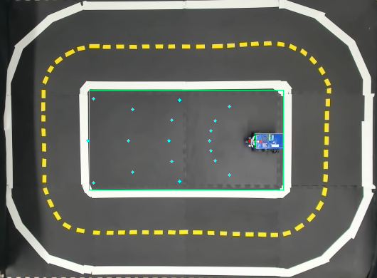
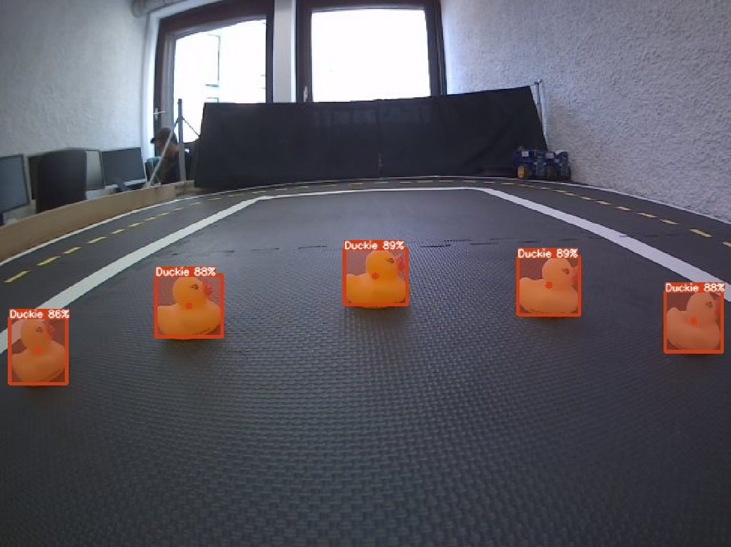
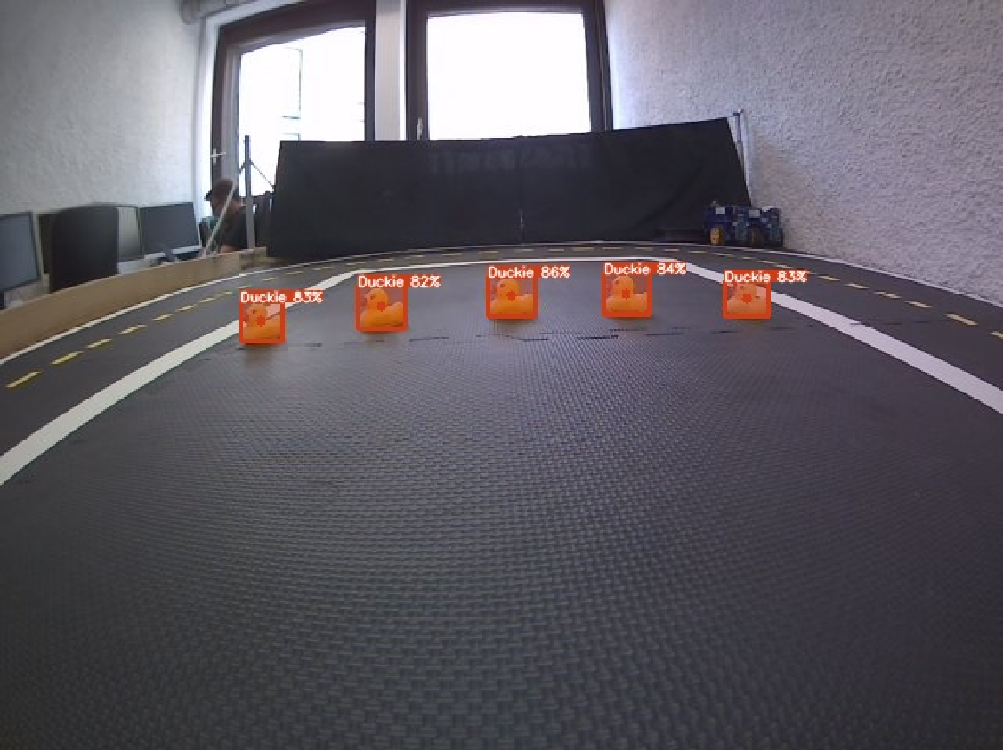
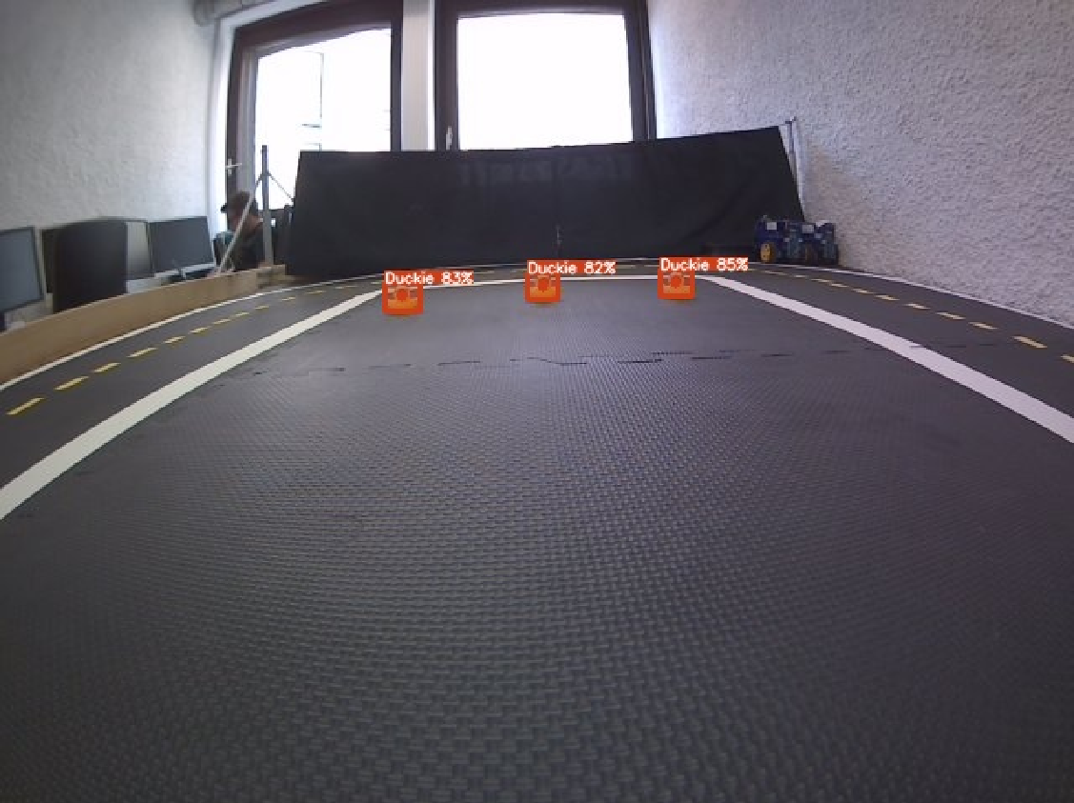
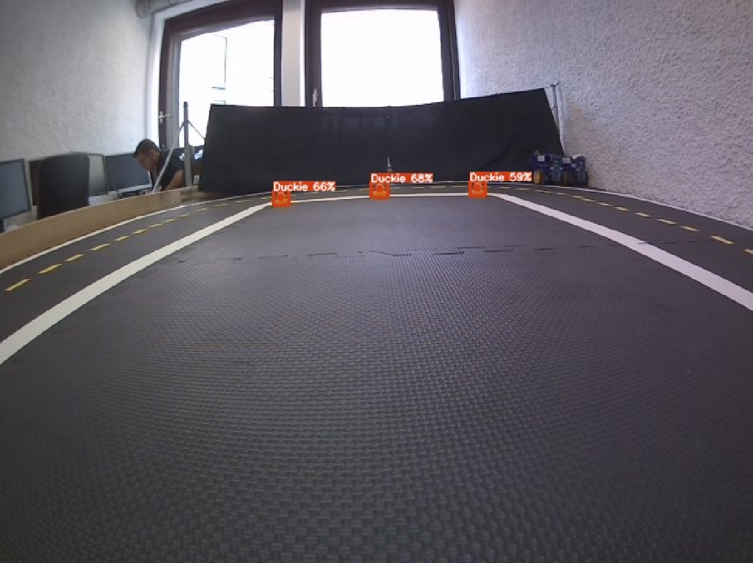
Case Study – Duckie Nominal Cases
Notes:
Here are experiment setup for Duckies.
We place Duckie on blue dots and measure confidence score.

Slide 28
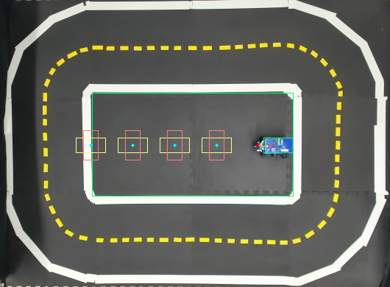
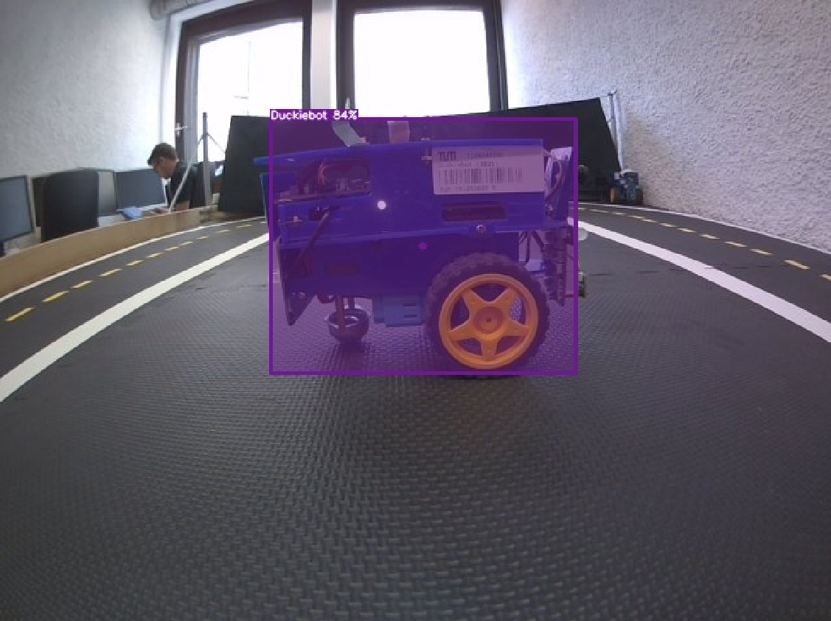
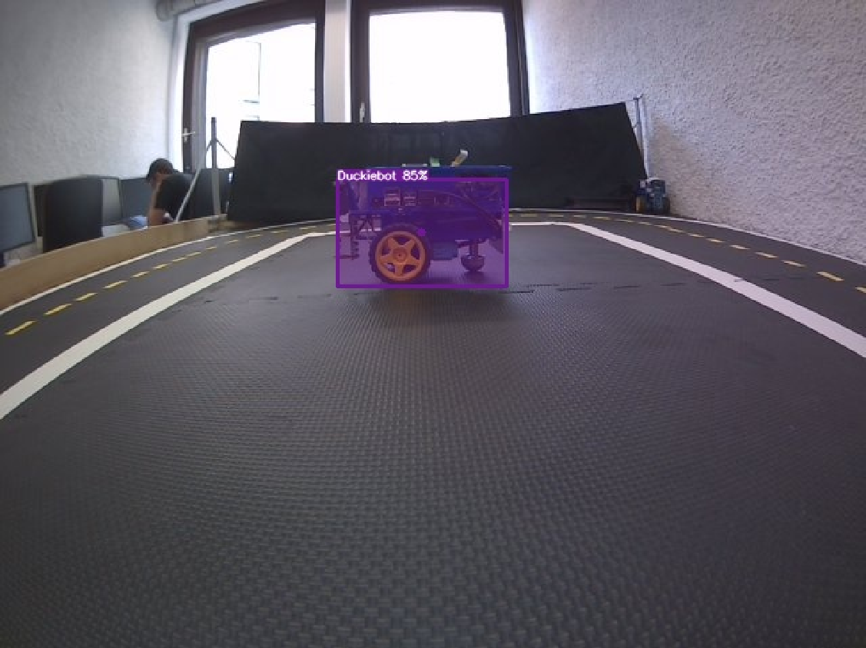
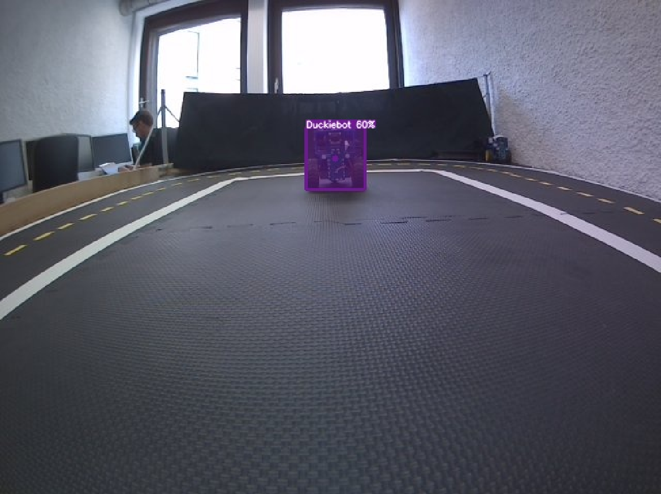
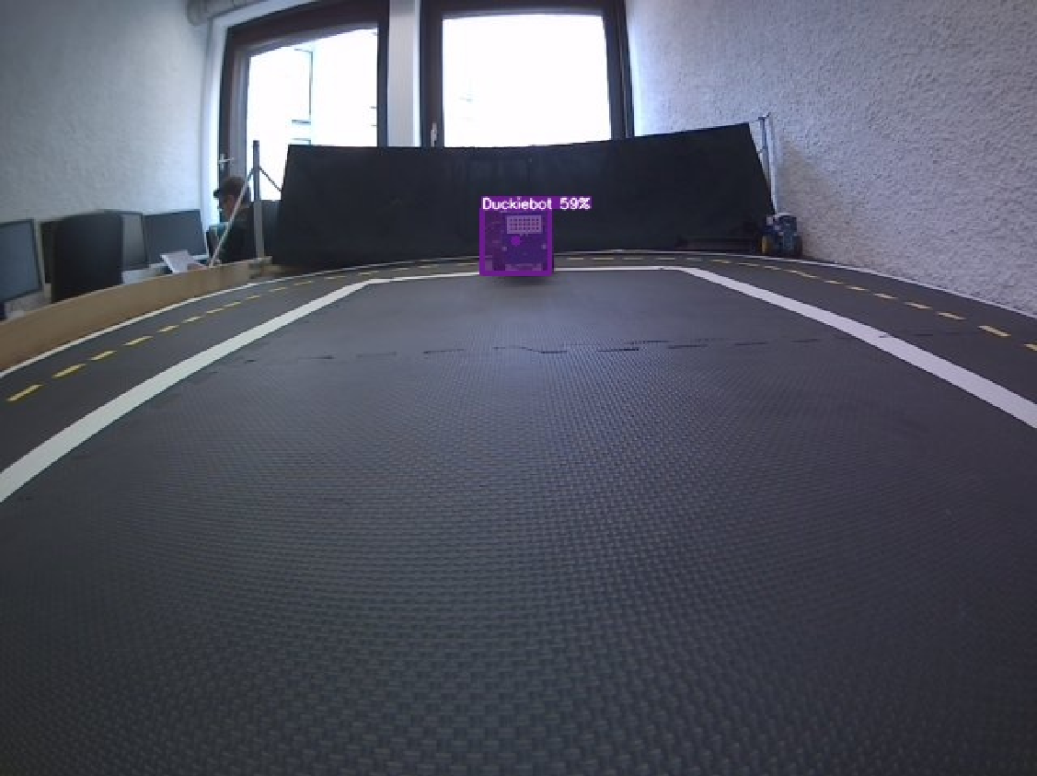
Case Study – Duckiebot Nominal Cases
Notes:
We also do the same for Duckiebot, but without different angles.

Slide 29
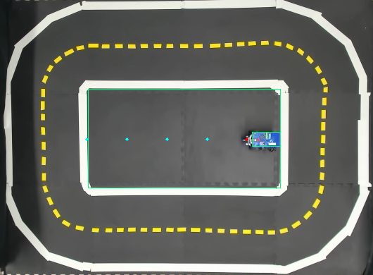
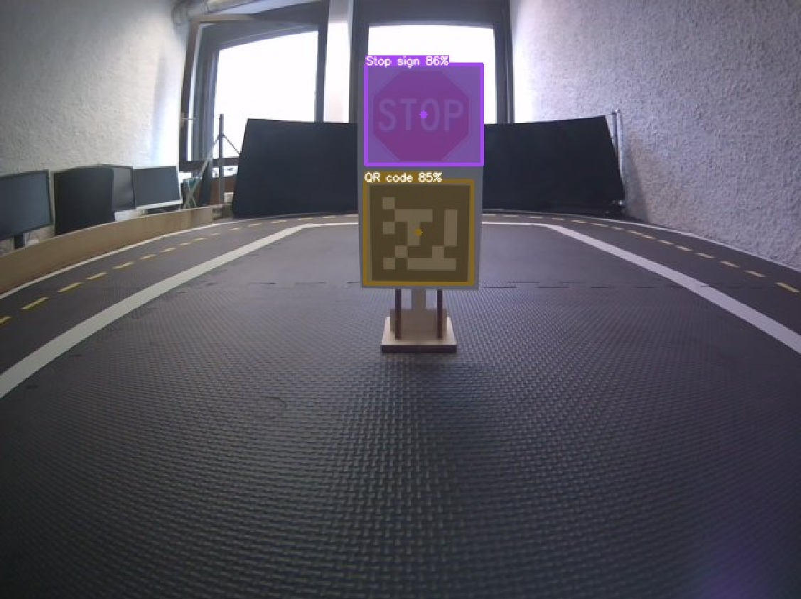
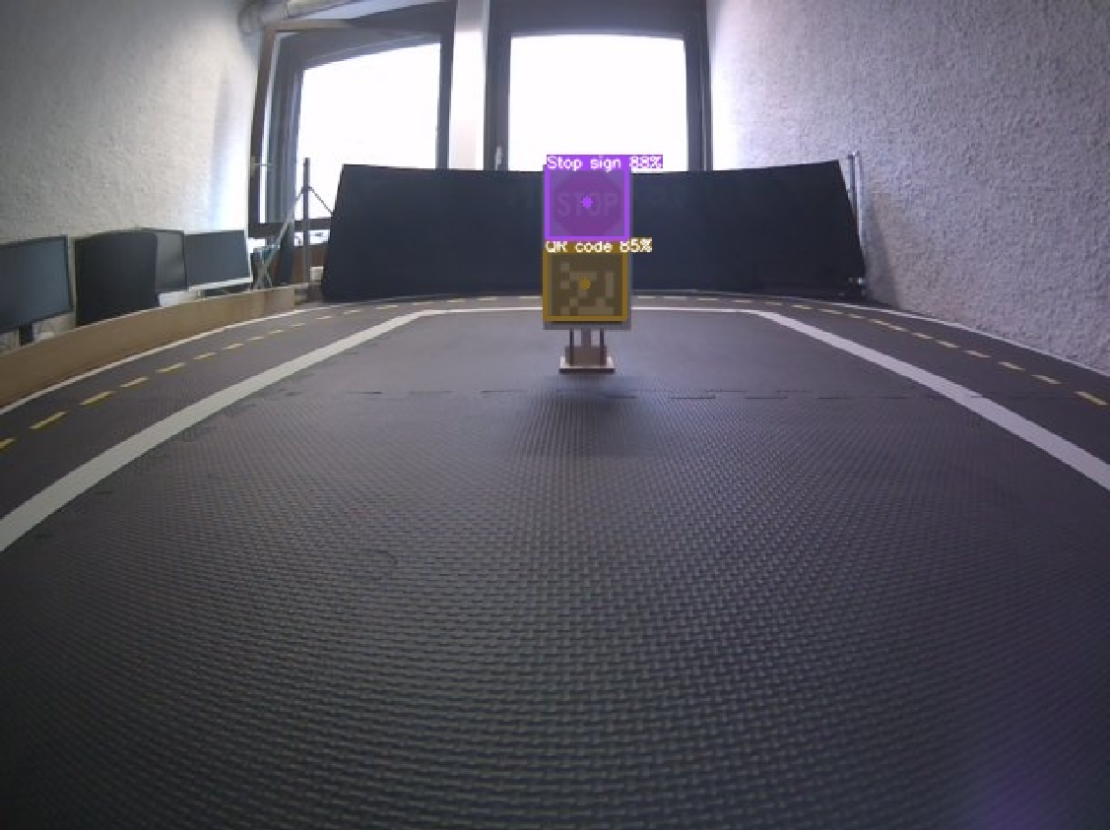
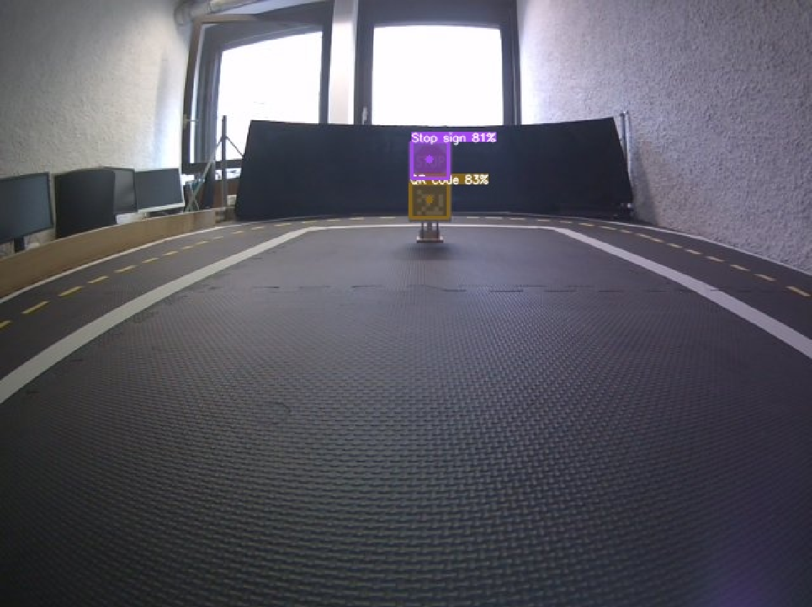
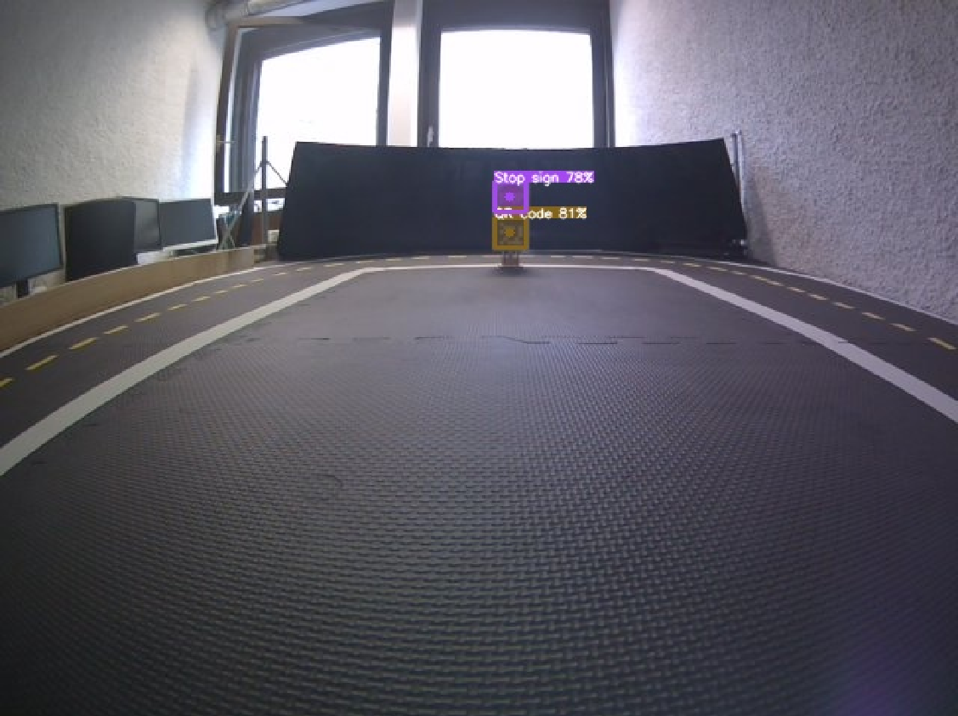
Case Study – Stop Sign Nominal Cases
Notes:
And here is for stop sign

Slide 30
Case Study – Nominal Case Summary
Notes:
This is the overall result for nominal cases.
And we can see the poor detection performance on a Duckiebot. This is because we are using a new Duckiebot design while the open-source dataset uses an old design.

Slide 31
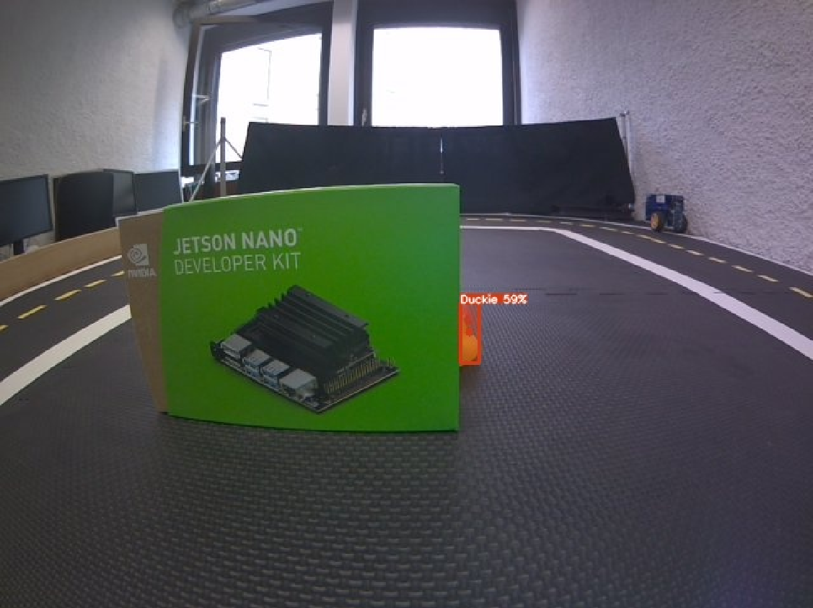
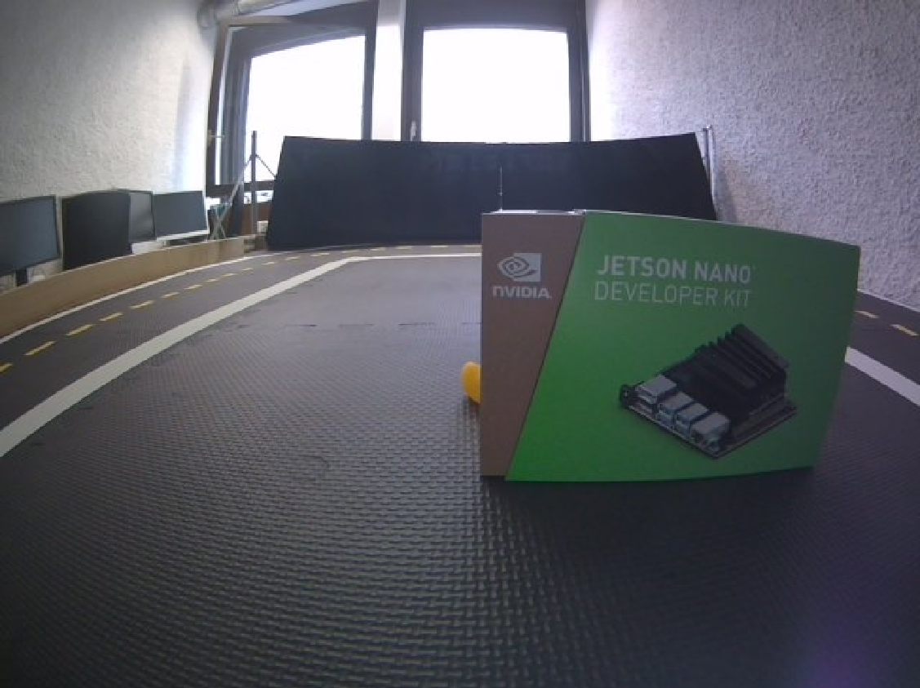
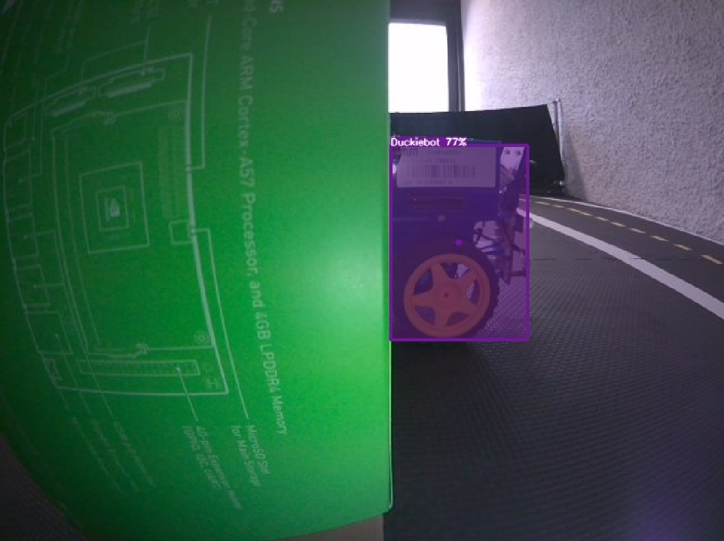
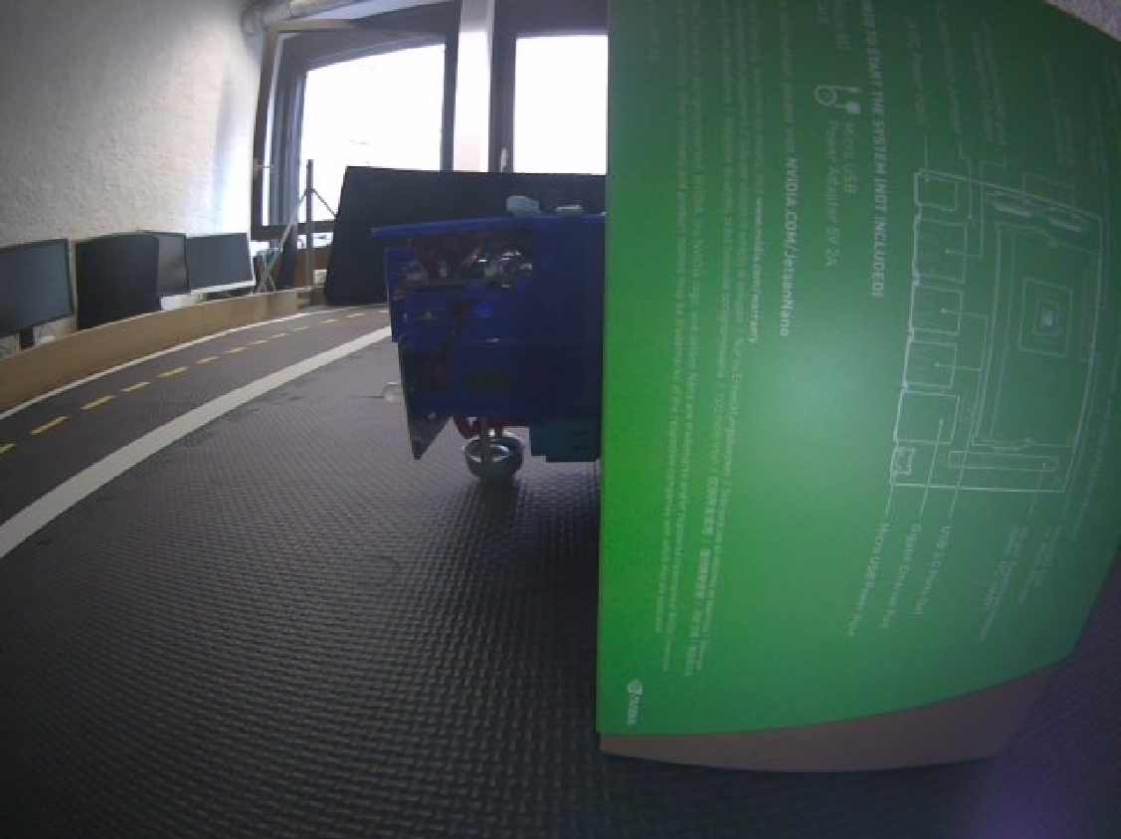
Case Study – Selected Safety-Critical Cases (Occlusion)
Duckie with 75% occlusion
Duckiebot with 50% occlusion
59% Confidence Score
Undetected
77% Confidence Score
Undetected
Duckie’s beak contains high feature.
Duckiebot’s wheels contain high feature.
Notes:
Let’s see our selected case study for safety critical cases.
The following slides will not only show when our model will detect objects but also how CNN actually works.
First, a Duckie is blocked from different direction, and we found that a model cannot detect when its beak is blocked. also, for a Duckiebot, when its wheel is blocked, a model also fail to detect.
This is because Duckie’s beak and Duckiebot’s wheel contain a great pattern and high feature.

Slide 32
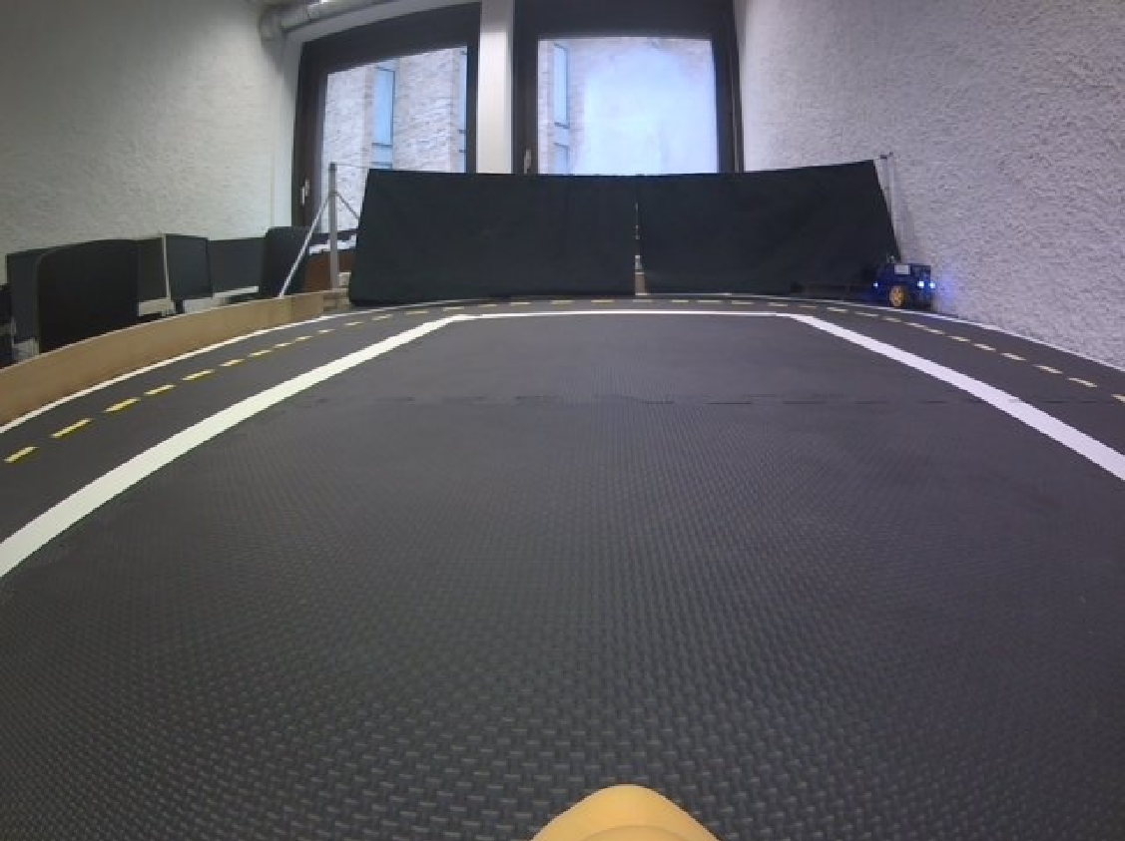
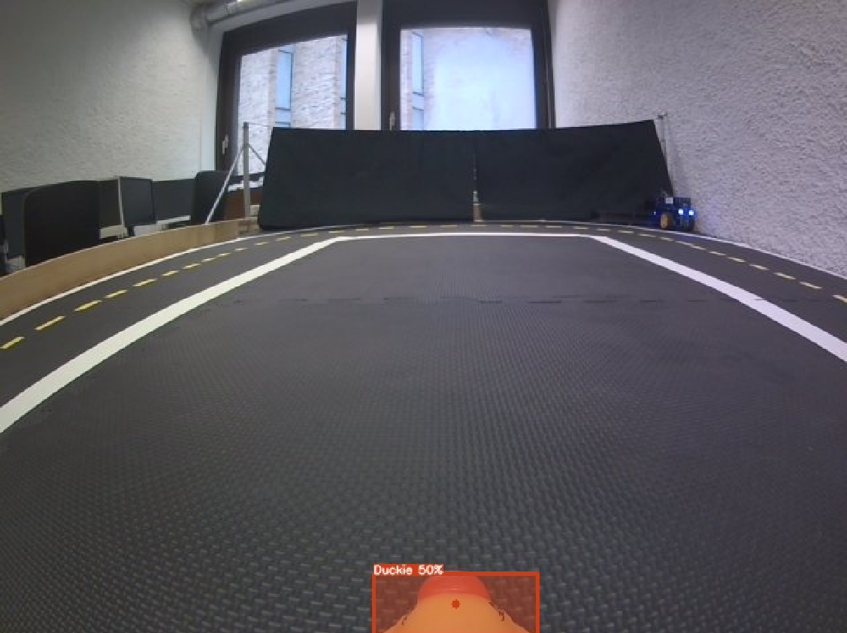


Case Study – Selected Safety-Critical Cases (Very Close)
Duckie positioned at 5 cm from the Duckiebot’s camera
Undetected
(Front)
50% Confidence Score
(Back)
79% Confidence Score
(Left)
67% Confidence Score
(Right)
Duckie’s beak contains high feature.
Notes:
Also, for the case when a Duckie is placed very close. We can see that a model cannot detect a Duckie only when its beak does not show.

Slide 33


Case Study – More Analysis
The back of the Duckiebot
Shared features of both designs:
Cables
Dot matrix
Picture from [1]
Notes:
Next for more analysis, this is very interesting because. Our model can detect two Duckiebots inside a Duckiebot because our model learns to understand pattern, and both cables and dot matrix are shared pattern between old and new designs.

Slide 34
Conclusion and Outlook

Slide 35
Conclusion
CNN-based Object Detection is viable for real-time application.
Models on GPU highly outperform models on CPU.
Using the GPU saves CPU utilization.
A custom dataset was collected to evaluate performance.
Prediction results can be used for simple decision-making.
Notes:
Let’s come to the conclusion.
First, we applied CNN-based object detection for a real-time application. Also, all models perform much better on GPU than on CPU, and running on GPU can save CPU utilization.
Moreover, we collected a custom dataset to evaluate models for our environment, and created simple decision making based on predicted results.

Slide 36
Research Opportunities
High CPU and RAM utilization → model quantization, converting weights and biases from FP32 to INT8
Extending our custom dataset
Adding reasoning capabilities (VLM/VLA)
Notes:
For research opportunities, because of high CPU and RAM utilization, one thing that can be done without extra cost is to quantize a model, meaning that we force a model from using 32-bit floating point to 8-bit integer, but it will probably come with a trade-off between speed and precision. Or, we can create larger dataset, this way we can ensure high precision on Duckiebot detection. Lastly, we can add reasoning capabilities to the system by using vision-language model (VLM) or vision-language-action model (VLA).

Slide 37
Reference
https://duckietown.com/
https://www.ultralytics.com/
https://github.com/duckietown/duckietown-objdet
https://cocodataset.org/
https://roboflow.com/
https://arxiv.org/abs/2405.05885
https://arxiv.org/abs/2506.13757

Slide 38
Thank You For Your Attention!

Slide 39
Extra Results

Slide 40
Safety-Critical Cases

Slide 41




Safety-Critical Cases

Slide 42




Safety-Critical Cases

Slide 43
Safety-Critical Cases
Duckie positioned at 5 cm from the Duckiebot’s camera
Front
Back
Left
Right

Slide 44
Model Performance

Slide 45

Model Size and FLOPs

Slide 46
Performance Comparison of YOLO Models

Slide 47
Performance Comparison of YOLO Models

Slide 48

Performance Comparison of YOLO Models

Slide 49

Performance Comparison of YOLO Models

Slide 50
Model Performance while Duckiebot is Stationary

Slide 51

Performance while a Duckiebot is stationary

Slide 52

Performance while a Duckiebot is stationary

Slide 53

Performance while a Duckiebot is stationary

Slide 54

Performance while a Duckiebot is stationary

Slide 55
Model Performance while Duckiebot is Running

Slide 56

Performance while a Duckiebot is running

Slide 57
Performance while a Duckiebot is running

Slide 58
Performance while a Duckiebot is running

Slide 59

Performance while a Duckiebot is running

Slide 60
VLM/VLA Examples

Slide 61

VLM Example
VLM-Auto [6] (Oct 2, 2024)

Slide 62

VLA Example
AutoVLA [7] (Jun 16, 2025)

